Slide 1
Chemical Engineering Thermodynamics 2
Ing. Julius C. Ahiekpor, PhD
Senior Lecturer
Chemical Engineering
juliusahiekpor@gmail.com

Slide 2
Course Content (Syllabus)
Thermodynamic properties of fluids mixtures
Phase equilibria
Solution thermodynamics
Chemical reaction equilibria
Thermodynamic analysis of real processes

Slide 3
Recommended Reference Books
Smith JM, Van Ness HC, Abbot MM, (2004). Introduction to Chemical Engineering Thermodynamics, 7th edition, The Mcgraw-Hill Chemical Engineering Series

Slide 4
Grading
Assignments 10%
Mid-sem Exams 20%
Final Exam 70%

Slide 5
Thermodynamic properties of fluids mixtures
Notes:
Ask students about thermodynamics

Slide 6
You will recall that we defined some four properties as a function of V, P, T, S known as the Gibbs equations for homogenous fluid of constant composition
Another set of equations are derived from these equations by the application of the exactness of a differential equation known as the Maxwell equations

Slide 7
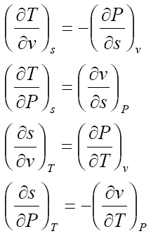
Maxwell equations

Slide 8
The Maxwell relations are very useful in evaluating H, U,S,G, and A in terms of the easily measurable properties P, V, and T.
Let see some applications of the Maxwell relations

Slide 9
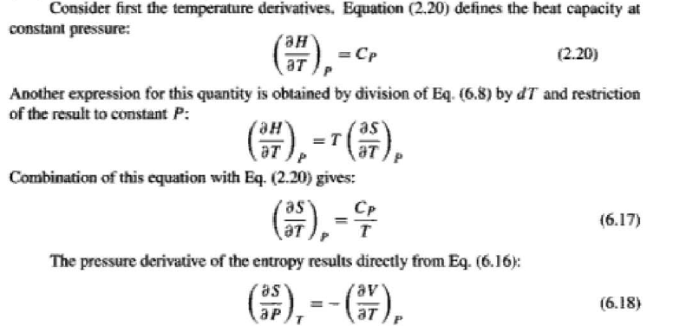

Enthalpy and Entropy as a function of T and P
The most useful property relations for the enthalpy and entropy of a homogeneous phase results when they are expressed as functions T and P
This information is contained in the derivatives $\left(∂H/∂T\right)p, \left(∂H/∂P\right)T, \left(∂S/∂T\right)p, \left(∂S/∂P\right)T$

Slide 10
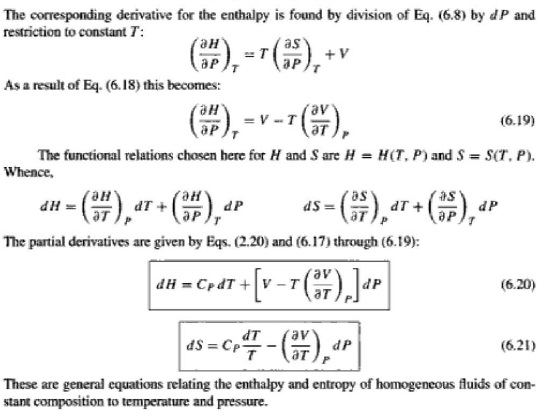

d$H=TdS+VdP−−−−−−Eqn 6.8$

Slide 11
Example (Refer to page 204 of Smith)

Slide 12
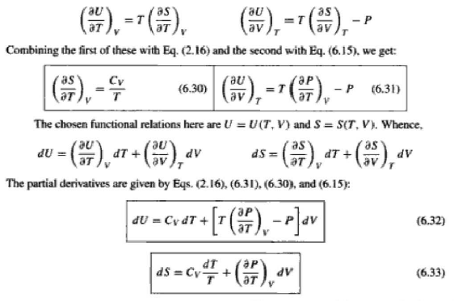
U and S as a function of V and T

Slide 13
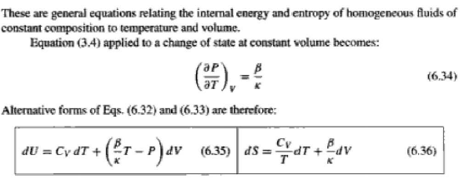

Slide 14
Example 2 (Page 218 of smith)

Slide 15
Equations of state (EOS)
In the calculations of energy, enthalpy, and entropy of a substance we need an accurate representation of the relationship among pressure, volume, and temperature.
Besides the tabular and graphical presentations of the p-v-T relationship, analytical formulations, called equation of state, constitute another way of expressing the p-v-T relationship.
The equations of state are convenient for performing the mathematical operations required to calculate u, h, s, and other thermodynamic properties. We will discuss the virial and Van de Walls equations of state.

Slide 16

The Van de Walls Equation of State
We will use the Van de Walls equation of state to illustrate the evaluation of thermodynamic properties.
the constant b accounts for the finite volume occupied by the molecules and the term a/v2 accounts for the attractive forces between molecules.
The Van der Waals parameters a and b can be determined from the critical properties since there is an inflection point at the critical isotherm.

Slide 17
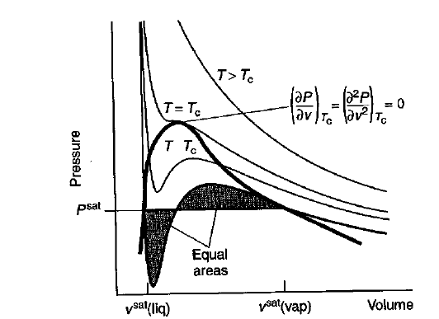



At the critical point we have
The first and second derivatives of P with respect to v are given by

Slide 18


Solving the two equations simultaneously yields
Using these to evaluate P critical

Slide 19
Example 2.3.3 (page 33)
One mole of propane gas is to be expanded from 0.001 m3 to 0.040 m3 while in contact with a heating bath at 100oC. The expansion is not reversible. The heat extract from the bath is 600 J. Determine the work for the expansion using the Van der Waals equation of state.

Slide 20




The Virial Equation of State
The virial equation of state relates the p-v-T behavior of a gas to the forces between molecules which is given as:
B, C, and D are called virial coefficient and are functions of temperature.
For a truncated virial equation with two terms we have
In this equation, B(T) can be estimated from the following equations:

Slide 21


Slide 22
Example 2.3.1
A three-liter tank contains two gram-moles of nitrogen at − 150.8oC. Estimate the tank pressure using the ideal gas equation of state and then using the virial equation of state truncated after the second term. Taking the second estimate to be correct, calculate the percentage error that results from the use of the ideal gas equation at the system conditions. Data for nitrogen: Tc = 126.2 K, Pc = 33.5 atm, and ω = 0.040

Slide 23
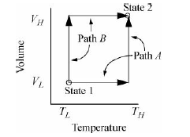
Residual Properties or Departure Functions Pathway
Another way to calculate thermodynamic properties is to use Residuals/Departure functions.
Suppose we desire to calculate the change in U in a process which changes state from (VL, TL) to (VH, TH).
We have two obvious pathways for calculating a change in U using {V, T} as state variables as shown in the figure below

Slide 24
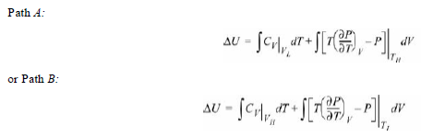
Path A consists of an isochoric step followed by an isothermal step.
Path B consists of an isothermal step followed by an isochoric step.
Naturally, since U is a state function, ΔU for the process is the same by either path.
Using the relation for dU(T,V); ΔU may be calculated by either.
However, using the above relations is Tedious. Since Cv depends on volume for a real fluid, we must find Cv by the EOS for at least one of the volumes. We must also insert the EOS for the integrand of the second integral.
To avoid these calculations, we use an equivalent approach of three stages.

Slide 25
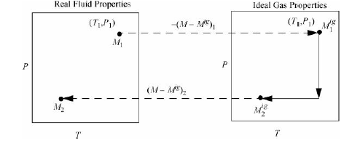
Residual properties
Steps:
Assume we can turn the fluid into an ideal gas
Find the properties fluid at the ideal state, which are easy to estimate
Turn the fluid back into a real fluid.
Combining the calculations, we get

Slide 26
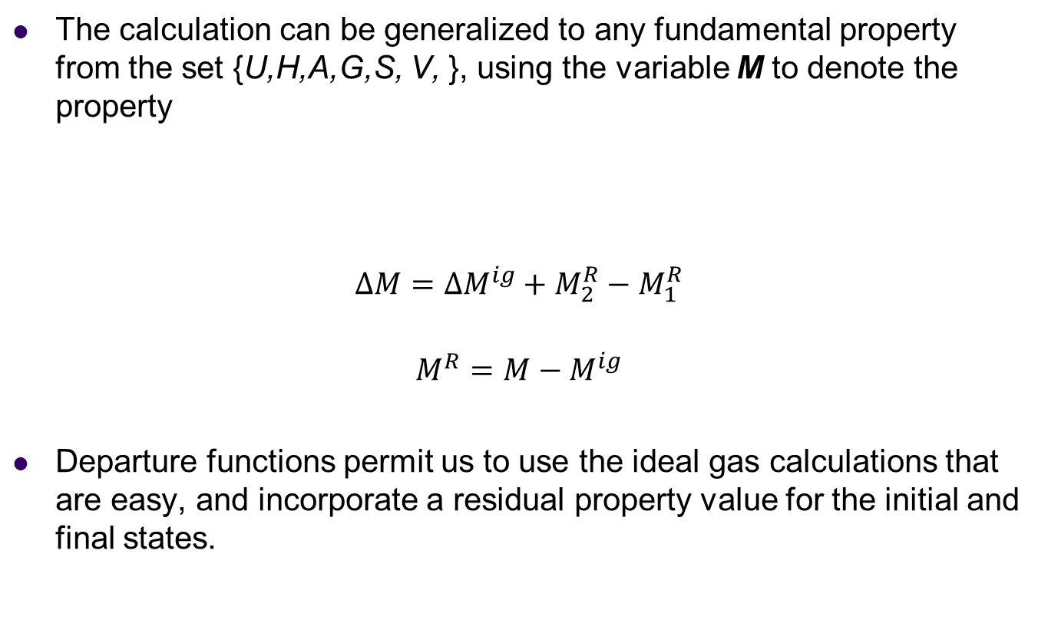
The calculation can be generalized to any fundamental property from the set {U,H,A,G,S, V, }, using the variable M to denote the property
$$∆M=∆M^{ig}+M_{2}^{R}−M_{1}^{R}$$
$$M^{R}=M−M^{ig}$$
Departure functions permit us to use the ideal gas calculations that are easy, and incorporate a residual property value for the initial and final states.

Slide 27
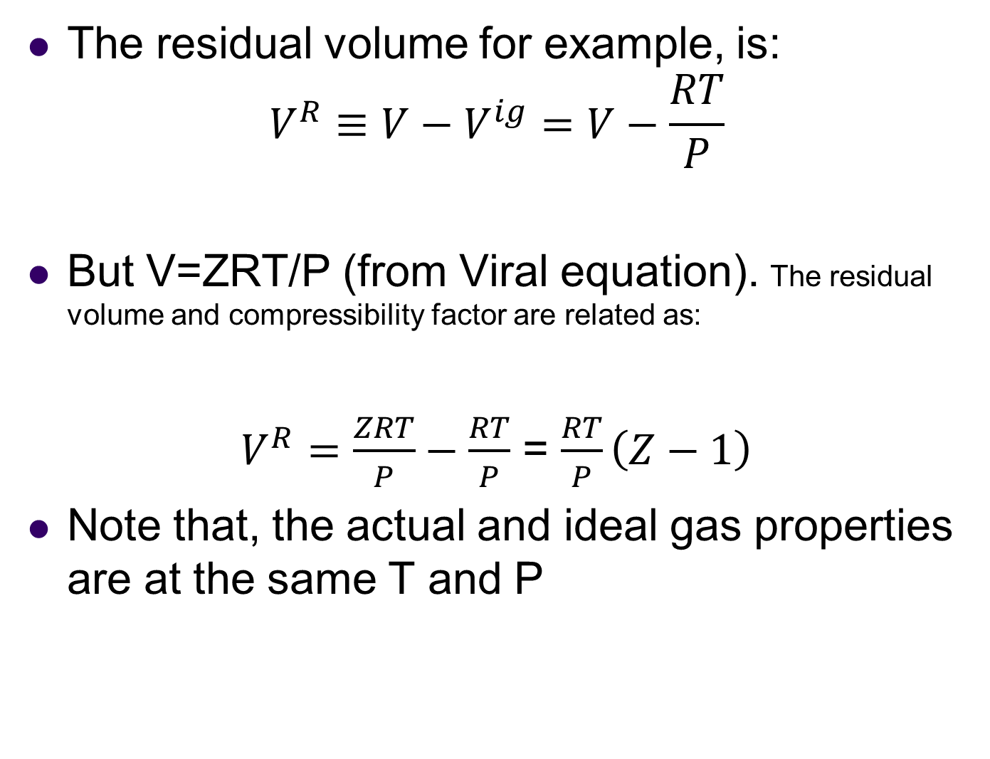
Residual Volume
The residual volume for example, is:
$$V^{R}≡V−V^{ig}=V−\frac{RT}{P}$$
But V=ZRT/P (from Viral equation). The residual volume and compressibility factor are related as:
$V^{R}=\frac{ZRT}{P}−\frac{RT}{P}$ = $\frac{RT}{P}\left(Z−1\right)$
Note that, the actual and ideal gas properties are at the same T and P

Slide 28
Gibbs Energy as a Generating Function
We have seen that, each of the thermodynamic properties/potentials U, H, A, and G is functionally related to a special pair of variables.
Gibbs function is expressed as a function of T and P: G = G(P,T)
Because these variables (T, and P) can be directly measured and controlled, the Gibbs Energy is a property importance.
It is often desirable to express the other thermodynamic properties in terms of Gibbs Energy given as a function of T and P

Slide 29
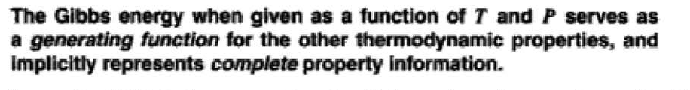
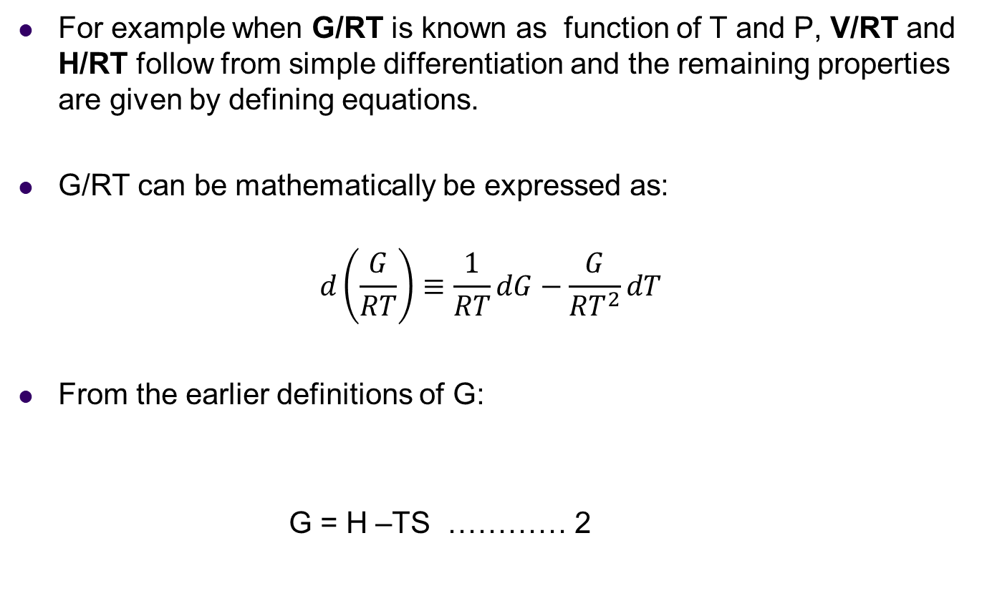
For example when G/RT is known as function of T and P, V/RT and H/RT follow from simple differentiation and the remaining properties are given by defining equations.
G/RT can be mathematically be expressed as:
$$d\left(\frac{G}{RT}\right)≡\frac{1}{RT}dG−\frac{G}{{RT}^{2}}dT$$
From the earlier definitions of G:
G = H –TS ………… 2

Slide 30




Substituting for dG by eqn (1) and for G by eqn(2), gives , after algebraic reduction:
From this equation, we can define the following properties:
Thus, when we know how G/RT or (G) is related to its canonical variables, T and P, we can evaluate all other thermodynamic properties by simple mathematical operations

Slide 31
Fundamental Property Relations
We can derive these fundamental relations for T, P, V from the laws of thermodynamics
As an example, the first law for a closed system undergoing reversible process with only PV work is given as:
dU = δQrev + δWrev
Also, from the second law, δQrev = TdS, the first law can be written as:
dU = TdS − pdV
This is what we did to define the Four Thermodynamic Potentials (U, H, G, A) which we used to derive the Maxwell relations
Notes:
Source: Nukyen page 20 section 2.2

Slide 32


From the TdS definition of internal energy, we see that U is a function of two independent variables S and V, that is, U = U(S, V):
This gives upon differentiation
Comparing the two equtions of dU, ie:
dU = TdS − pdV and
We have new definition of temperature and P as:

Slide 33


Similarly, the change in enthalpy (H = U + pV) is given by
dH = dU + d(pV) = TdS − pdV + pdV +Vdp
dH = TdS + Vdp
The change in enthalpy in terms of two independent variables S and p is
Comparing, gives:

Slide 34
Phase Equilibrium

Slide 35
Introduction
Our discussions of thermodynamics have largely focused on Pure Substances or substances with constant-composition mixtures.
However, in many chemical and allied processes, important mass-transfer operations are encountered and composition changes are desired outcomes.
These processes include distillation, extraction, absorption, etc.
These processes bring different phases of different composition into contact and when the phases are not in equilibrium, mass transfer alters their compositions.
Most commonly encountered coexisting phases in industry include vapor/liquid, liquid/liquid, vapour/solid, and liquid/solid systems; and we need to determine the properties of these mixtures at equilibrium (saturation).
Notes:
Test the class knowledge of PURE SUBSTANCES. Ask them to give examples.

Slide 36
The determination of phase equilibrium is one of the most important estimations to make.
The ability to understand, model, and predict phase equilibria is particularly important for designing separation processes.

Slide 38
Pure Substances ? (Recall)
A pure substance is a system which is
(i) homogeneous in composition,
(ii) homogeneous in chemical aggregation, and
(iii) invariable in chemical aggregation.
“Homogeneous in composition” means that the composition of each part of the system is the same as the composition of every other part
“Homogeneous in chemical aggregation” means that the chemical elements must be combined chemically in the same way in all parts of the system

Slide 39
Invariable in chemical aggregation” means that the state of chemical combination of the system does not change with time
Examples of pure substances include:
Water (solid, liquid, and vapour phases);
Mixture of liquid water and water vapour;
Carbon dioxide, CO₂;
Oxygen, O₂; and
Mixtures of gases, such as air, as long as there is no change of phase.

Slide 40



Measure of composition
Mass/mole fraction?
Molar concentration?
Molar mass of a mixture/solution?

Slide 41
Phase rule: The Proof
The phase rule for nonreacting systems is given as
F = 2-π+M
This represents the number of variables that may be independently fixed for an intensive state of a PVT system containing M chemical species and n phases.
How is this achieved? (Refer to page 84 of Nguyen or page 340 of Smith) – HOME WORK

Slide 42
Vapour-Liquid Phase Equilibium

Slide 43

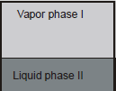
Criteria for VL Phase Equilibrium
Consider an isolated system of a single component
The equilibrium system consists of a vapor phase (I) and a liquid phase (II).
For the entire system, the total moles, internal energy, volume, and entropy, all of which are extensive variables, are the sums of these quantities in the two phases, that is,
Consider the internal energy to be a function of V, S, and N; ie U=U(S,V,N)

Slide 44





We can calculate the change in the internal energy for the vapor phase I due to changes in S^{I},V^{I}, and N^{I}.
The partial derivatives can be written in terms of thermodynamic properties.
Solving the above equation for dS^{I} yields
Similarly, for the liquid phase we have
The entropy change of the entire system is

Slide 45


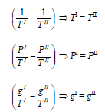
Since the system is isolated, the total number of moles, total internal energy, and total volume are constant.
Therefore, change in entropy becomes
At equilibrium, the value of S is at a maximum. Hence dS = 0. Since U^{I}, V^{I}, and N^{I} are independent, dS can be equal to zero only if the coefficients of dU^{I}, dV^{I}, and dN^{I} must all equal to zero.

Slide 46
Therefore, the equilibrium condition for a two phases system is satisfied if both phases have
the same temperature,
the same pressure, and
the same chemical potential or Gibbs free energy.
This is a very significant result. In other words, G^{Liquid} = G^{Vapor} is a constraint for phase equilibrium.
None of our other thermodynamic properties, U, H, S, and A is equivalent in both phases.

Slide 47
This means that, If we specify phase equilibrium must exist and one additional constraint (e.g., T), then all of our other state properties of each phase are fixed and can be determined by the equation of state and heat capacities.
Only needing to specify one variable at saturation to compute all state properties should not come as a surprise, based on our experience with the steam tables.
The constraint of G^{Liquid} = G^{Vapor} is simply a mathematical way of saying “saturated.”
Confirm this by selecting from the steam tables an arbitrary saturation condition and calculate G = H – TS for each phase ( CLASS ASSIGNMENT)

Slide 48
The Clapeyron Equation
Temperature and pressure are not independent for a pure species that exists in two phases at equilibrium.
We can apply the concepts of equilibrium to obtain simple equation for the vapor-pressure dependence on temperature at low pressures.
At equilibrium between α and β phases, where α and β can represent the vapor, liquid, or solid phases, we have
T^{α} = T^{β},
P^{α} = P^{β}, and
g^{α} = g^{β}

Slide 49



the differential changes in Gibbs free energy of each phase must be equal at equilibrium
dg^{α} = dg^{β}
Applying the fundamental property relation for g to each phase yields;
− s^{α}dT + v^{α}dP = − s^{β}dT + v^{β}dP
Rearrangement gives
We have g^{α} = g^{β} ⇒ h^{α} − Ts^{α} = h^{β} − Ts^{β}
Solving for the difference in entropy yields

Slide 50

Substituting the expression for entropy gives
This equation called the Clapeyron equation, is a general relationship among pressure, temperature, volume change, and enthalpy change for a single component, two-phase system at equilibrium.
This equation can be applied to any kind of phase equilibrium including solid-vapor and solid-liquid equilibria by substituting the alternative sublimation or fusion properties into the equation.

Slide 51



The Clausius-Clapeyron Equation
For vapor-liquid equilibrium, we have
When applied to equilibrium involving a vapor phase, the pressure is referred to as the vapor or saturation pressure and will be denoted by P^{sat}.
In the region far from the critical point, v^{l} << v^{v}, the volume of the liquid is negligible compared to the volume of the vapor. If the vapor obeys ideal gas law, the equation becomes
We then use calculus to change the way we write the Clapeyron equation:

Slide 52


Rewriting gives
In this equation, Δhvap = h^{v} − h^{l} is the enthalpy of vaporization of the substance at temperature T.
This equation is called the Claysius-Clayperon Equation
Integrating this equation between two saturation states yields

Slide 53
The Clausius Clapeyron equation can be used to correlate, interpolate, and extrapolate vapor data or to estimate latent heats from vapor pressure data.

